Slide 1
woopy

Slide 2
woopy
Submitted to:-
Mr. Farman
Submitted by:-
Achyut Kumar Tiwari
Arpan Khandelwal
Abhishek Yadav
Abhishek Singh
Kuldeep Kumar

Slide 3
Overview
Our Project is a Web based car racing game . The objective of this game is to survive as long as possible and get to the High scores in the shortest possible time while avoiding the obstacles on the tracks.

Slide 4
DESCRIPTION
The game is created in Js , html5 AND Css.
Initially the game was created for Linux and Window platform.
The User will play the game to achieve highest score.
The user can select the playing mode according to its choice weather he/she wants to play in medium mode or in hard mode.
Although the game is running, the scores are automatically increasing.
On collision the scores were stopped.

Slide 5
DESCRIPTION
On collision, the user will have three choices .
According to his choice, the user will redirected to particular Activity

Slide 6
SPECIFICATIONS
The backend coding of game is done in Javascript language. The compiling and editing is done in Mono Developer..
This is 2D game with 2 different control settings and different playing modes.
The car speed is vary by different playing modes according to user's choice.

Slide 7
specifications
The compatible Web game is user friendly which is capable to entertain the user and also increase the interest of user creating different obstacles on the path of player's car.
The delay between the obstacles cars is vary by different playing modes.
In medium, the delay is 3.7secs while in hard mode the delay is 2.0secs.

Slide 8
WORking
Step 1 : The user has to click on the link given below.
https://arpan-khandelwal.github.io/woopy/
This game not need any special permissions from user.

Slide 9
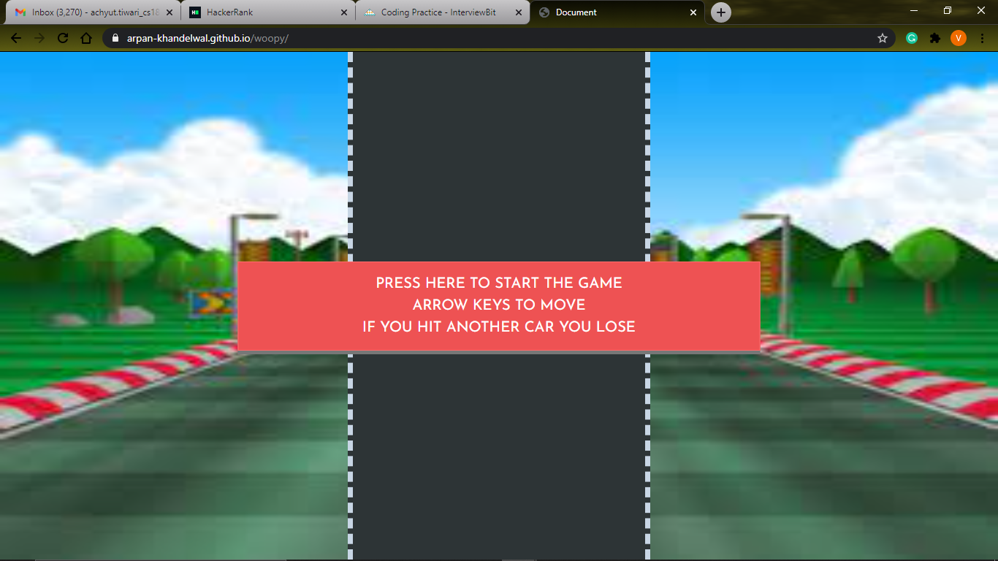
WORking
Step 2: Click on the link then user will redirect to front activity of the game in which user have to click on screen to enjoy or start the game.

Slide 10
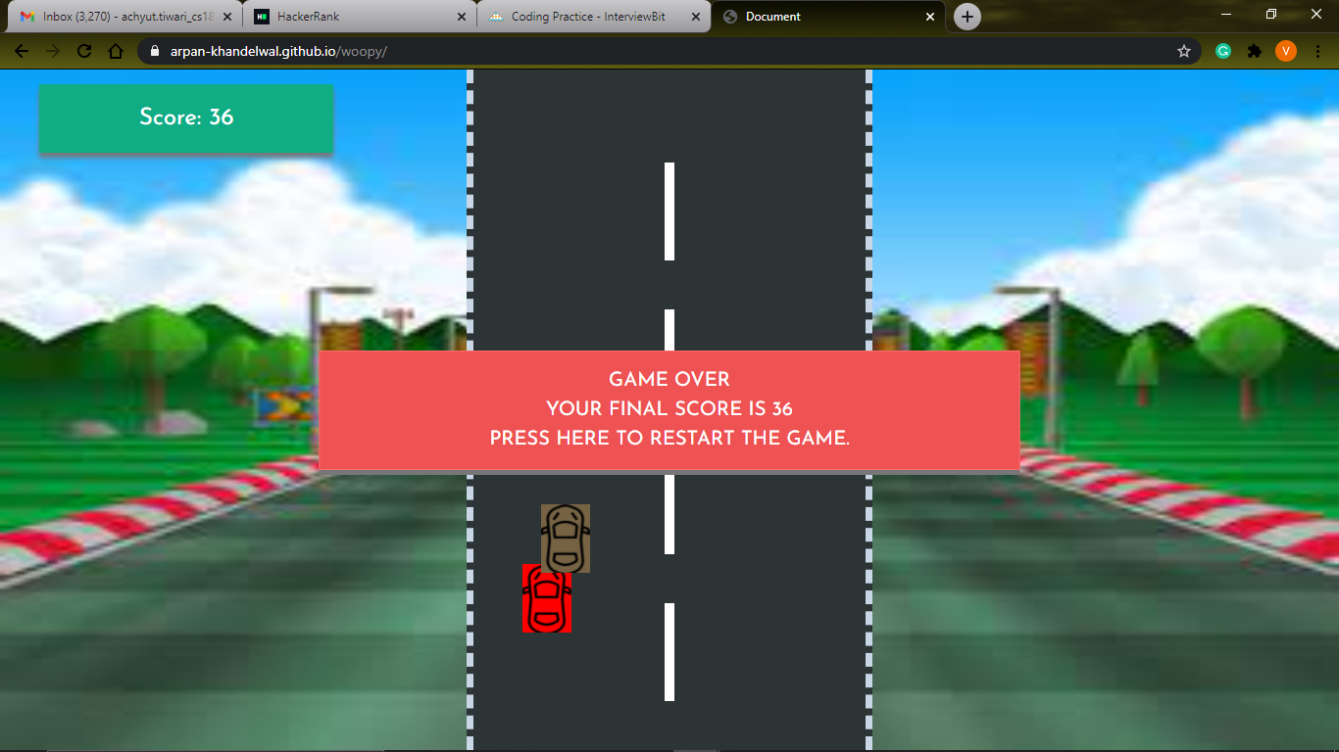
WORking
Step 3 : Use arrow keys to move the car if you hit another car Game Over message shown there with your highest score.

Slide 11

Thank you

